Slide 1
MAT 3749 Introduction to Analysis
Fall 2021
http://myhome.spu.edu/lauw

Slide 2
Dr. Wai W. Lau
Dr. Lau
Wai

Slide 3
Dr. Wai W. Lau
Dr. Lau
Wai =
Y

Slide 4
Dr. Wai W. Lau
Dr. Lau
Wai =
=
Y
Why?

Slide 5
Course Web Page
http://myhome.spu.edu/lauw
Link to this document and other course information

Slide 6
Office Hours
See course web page
By Appointment

Slide 7
Introduction
…nobody (well, almost nobody) understands calculus fully (especially the theoretical parts) the first time around; multiple exposures are required.

Slide 8
What to expect from an Analysis course?
…taking the first course in advanced calculus or real analysis in which students grapple with limits, and often at the same time as learning to prove, has never been exactly easy for anybody.

Slide 9
What to expect from an Analysis course?
…Advanced calculus is a wonderful course in which far too many students previously successful in mathematics fail (or at least experience great frustration in achieving
minimally acceptable results).

Slide 10
What to expect from an Analysis course?
…Like many others, I found real analysis the hardest of the math major requirements; it took me half the semester to catch on. So don’t worry: just keep at it, be patient, and have fun.

Slide 11
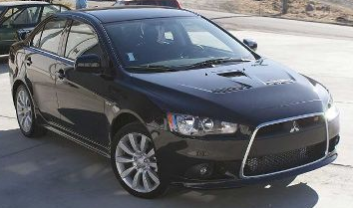
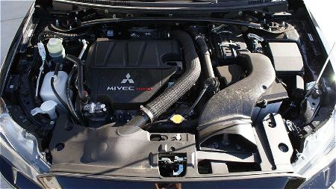
Cars, Drivers, Mechanics, Engineers, …

Slide 12
Introduction
One of the goals of this course is to continue improving your ability to read, write, and critique mathematical proofs
We are going to learn how to do prove in the context of Calculus/Analysis.

Slide 13
Prerequisites
Calculus III and (Discrete Mathematics or MAT 3100)

Slide 14
Text
Free Textbook will be provided.

Slide 15
Objectives
By the end of the course, a student should
know the basic properties of cardinality of sets
know the basic properties of the real number system
know the basic properties of the topology of the real line
understand the concepts of Supremum and Infimum
understand and able to apply the precise definitions of limits and continuity of functions
understand the concept of uniform continuity
understand and able to prove and apply the Intermediate Value Theorem

Slide 16
Objectives
understand the differentiability of functions and the basic differentiation rules
understand and able to prove and apply the Intermediate Value Theorem for Derivatives and Mean Value Theorem
understand and able to prove and apply L'Hospital's rule
understand and able to prove and apply Taylor's Theorem

Slide 17
What Would You Expect to See in Upper Division Courses at SPU?

Slide 18
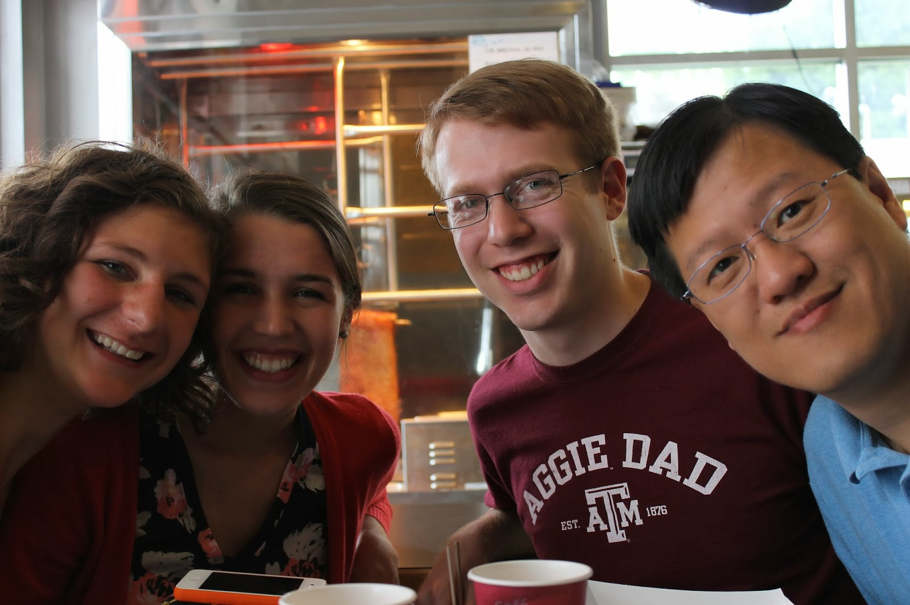
A Conversation Between Liz, Karla, and Josh…

Slide 19
Memorization Vs Understanding

Slide 20
Expectations
Able to provide written explanations of the ideas behind key concepts.
Able to clearly present and explain solutions to problems in both written and verbal form.
Read and write proofs appropriate at this level.
Able to work as a team to solve problems.
Able to work independently to solve problems.
Able to apply knowledge to new situations.

Slide 21
Homework
Homework problem sets will be assigned.
All work must be typed and print single-sided.
The ONLY references you can use are the textbook and the lecture note. You cannot use any other resources such as other books, software, and the internet.

Slide 22
Homework
*.doc ←Type with Equation Editor
*.docx ←Saved to.docx to type with MS Equation Editor

Slide 23
Homework
Group HW
Individual HW

Slide 24
Group Homework
You are required to work together in a group of 2 or 3.
I set up four initial groups.
You may switch groups based on mutual agreements.

Slide 25
Individual Homework
No discussion with any other person, except may be the instructor.
Discussing or copying homework is considered as an act of academic dishonesty

Slide 26
Homework
Homework must be written with proper logical format. Otherwise, no points will be given.
The instructor may make you redo your homework sets (again and again) until the presentations are acceptable.

Slide 27
Homework
Staple your Homework. Points will be taken off if you fail to do so.
Homework is due at the beginning of the class. Absolutely no late homework.

Slide 28
Class Participation:
1. I will ask questions during the class time.
2. There are group classwork/labs in some class sessions.
3. You are expected to have printed handouts.
At the end of the quarter, your grades on class participation will be determined by the above activities and other observations by the instructor.

Slide 29
Exams
3 mid-term exams and a final

Slide 30
Points Distribution
Exam 1 | 10/08 | 80 points
Exam 2 | 11/01 | 100 points
Exam 3 | 11/15 | 100 points
Final | 11/23, 9-11am | 40 points
Homework | Daily | 60 points
Class Participation | Daily | 20 points

Slide 31
Final Class Grade
90% | A Range
80% | B Range
70% | C Range
60% | D Range
Below 60% | E

